Slide 1
POLYGON CLIPPING
Each edge of the polygon must be tested against each edge of the clipping window, usually a rectangle.
As a result, new edges may be added, and existing edges may be discarded, retained, or divided.
Multiple polygons may result from clipping a single polygon.

Slide 2
SUTHERLAND HODGEMAN POLYGON CLIPPING
This algorithm is based on a divide and-conquer strategy that solves a series of simple and identical problems that, when combined, solve the overall problem.
The simple problem is to clip a polygon against a single infinite clipping edge.
This process outputs the series of vertices that define the clipped polygon
Four clipping edges, each defining one boundary of the clipping window, are used to successively to fully clip the polygon.

Slide 3
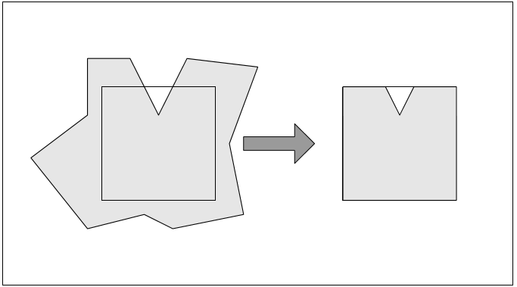
SUTHERLAND HODGEMAN POLYGON CLIPPING
Before Clipping
After Clipping

Slide 4
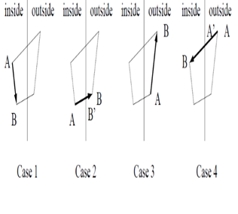
SUTHERLAND HODGEMAN POLYGON CLIPPING
CASE1: Inside→Inside---------End
CASE2: Inside→Outside-----Intersection
CASE3: Outside→Outside----Nothing
CASE4: Outside→Inside----- Intersection,End

Slide 5
SUTHERLAND HODGEMAN POLYGON CLIPPING CASES
CASE1: Both vertices are inside : Only the second vertex is added to the output list
CASE2: First vertex is inside while second one is outside : Only the point of intersection of the edge with the clip boundary is added to the output list
CASE3: Both vertices are outside : No vertices are added to the output list
CASE4: First vertex is outside while second one is inside : Both the point of intersection of the edge with the clip boundary and the second vertex are added to the output list

Slide 6
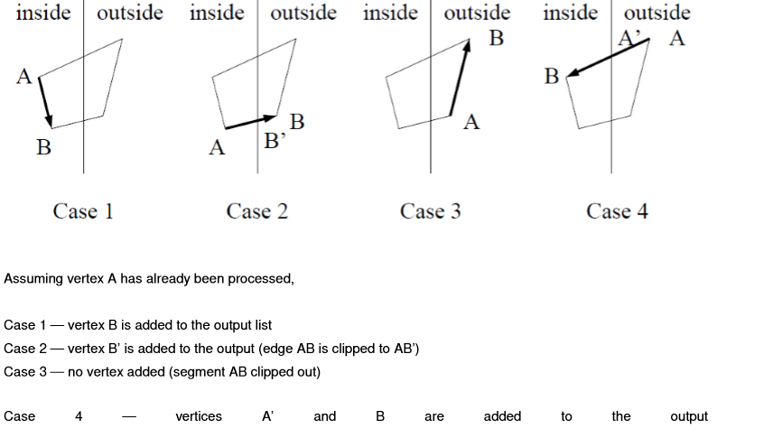
SUTHERLAND HODGEMAN POLYGON CLIPPING

Slide 7
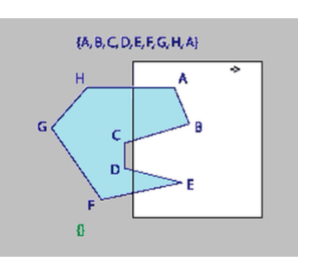
SUTHERLAND HODGEMAN POLYGON CLIPPING

Slide 8
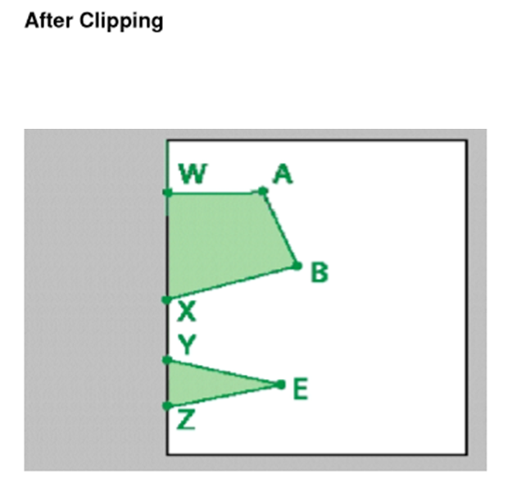
OUTPUT LIST→(B,X,Y,E,Z,W,A)

Slide 9
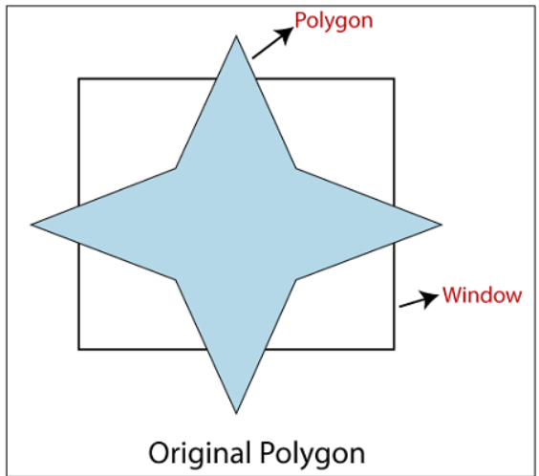
Home work
A
H
B
G
C
F
D
E

Slide 10
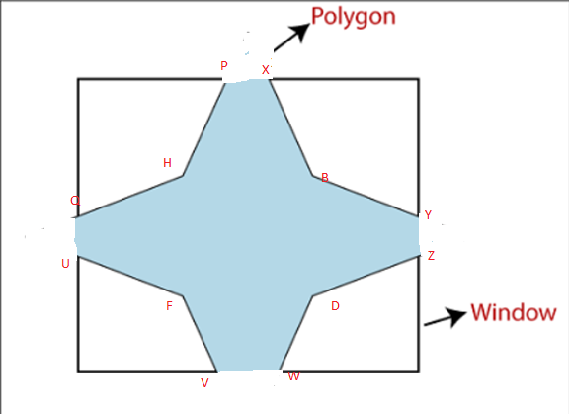
AFTER CLIPPING:
OUTPUT LIST→(X,B,Y,Z,D,W,V,F,U,Q,H,P)

Slide 11
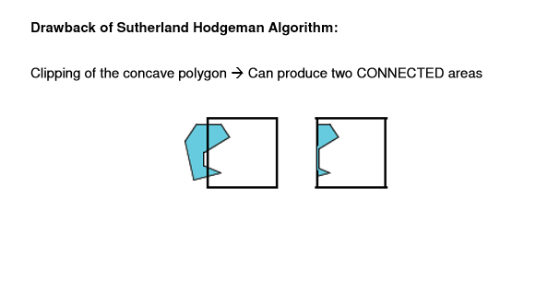

Slide 12
LOGICAL CLASSIFICATION OF INPUT DEVICES
• Locator Devices
• Stroke Devices
• Valuator Devices
• Choice Devices
• Pick Devices

Slide 13

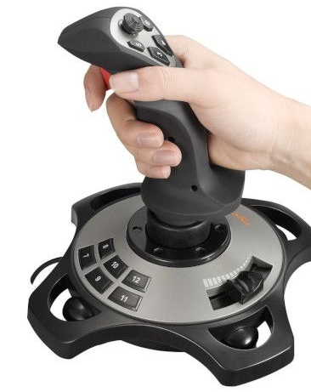
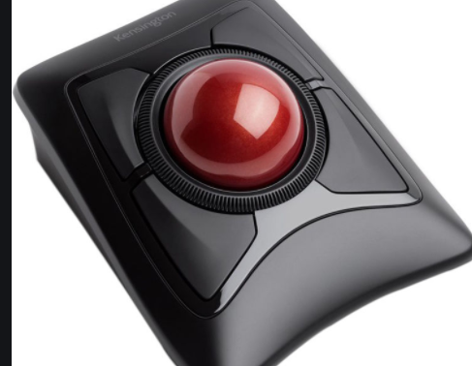
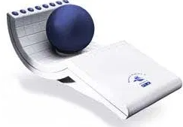
Locator Devices
To select a co-ordinate on the screen.
• When the cursor is at the desired position on the screen, a button is clicked to select that co-ordinate point.
• Mouse, joystick, trackballs, space balls, digitizers.. Can be used as locator devices.

Slide 14
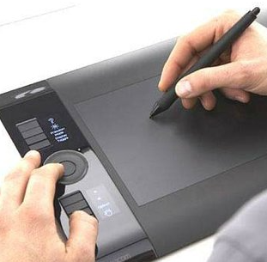
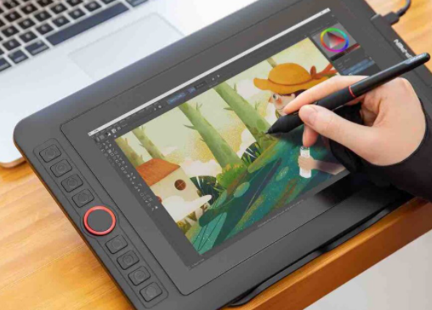
Stroke Devices
A sequence of co-ordinate points can be selected.
• Locator devices in continuous mode.
• Graphical tablet or digitizer can also be used.

Slide 15
Valuator Devices:
To give scalar input values like temperature and voltage levels.
• Floating point numbers within any range can be given as input
E.g.: Set of Control dials.
• Rotation in one direction increases the values..
• Slide-potentiometers, keyboards with a set of numeric keys can also be used.
• Display sliders, buttons, rotating scales and menus on screen.

Slide 16
Choice Devices:
To construct a picture.
• Selection from a list or menu of alternatives.
• Either a keyboard or stand-alone “button box” can be used for selecting item from the menu.
• The selected screen position(x,y) is compared with the menu option.
Touch panels are also used.

Slide 17
Pick Devices:
To select parts of the screen that are to be edited.
• Choice devices can be used here.
• If the selected point lies in the bounding rectangle of a particular object, then that’ll be selected.
• If it lies in the area of 2 objects, then the squared distance from the point to the line segment both the objects are compared.

Slide 18
The different modes are:
Request mode
Sample mode
Event mode
Some terminology:
measure - information returned to user program
one or more characters from a keyboard
position for a locator
trigger - manner in which device user can signal the computer
that input is available
Enter key
button on locator

Slide 19
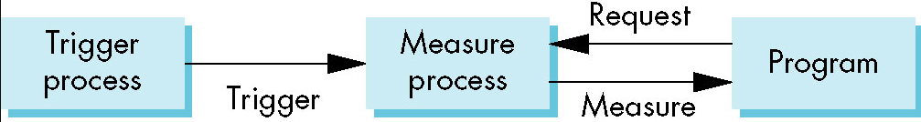

Request mode
The measure of the device is not returned to the program until the device is triggered.

Slide 20
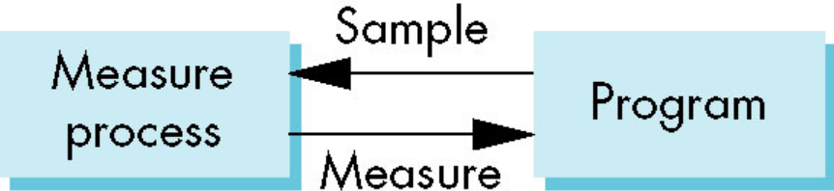
Sample mode
Input is immediate - Measure is returned immediately after the function is called in the user program (device sample).
• No trigger needed
• Useful in apps where the program guides the user.

Slide 21
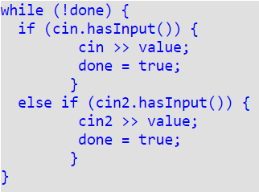
Sample mode - Example

Slide 22
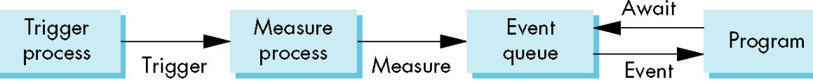
Event mode
Measure is place on an event queue
Can handle multiple inputs
• When device triggered an event is generated
• Identifier for device placed in the event queue
• Event queue process is independent of the application, asynchronous

Slide 23
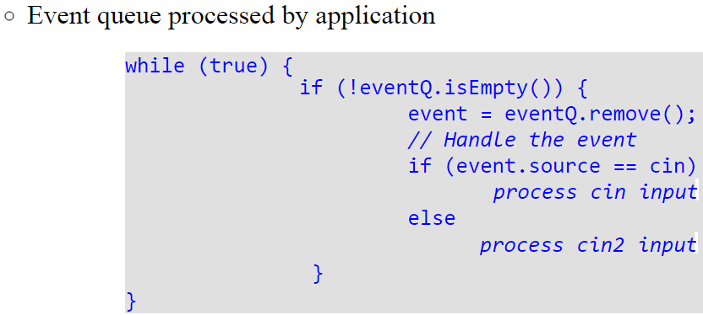
Event mode

Slide 24
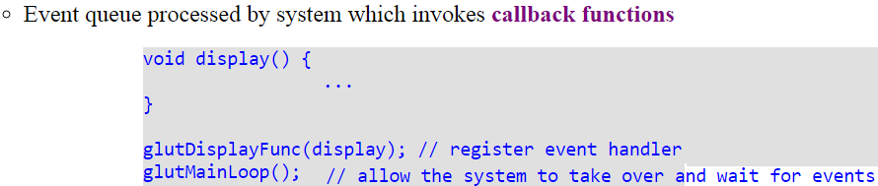
Event mode

